Slide 1
Notes:
Carolyn

Slide 2
Eda and Cliff Viner
Community Scholars Foundation, Inc.
MISSION
To educate student leaders of character who will graduate and contribute to their families and community
Notes:
Carolyn

Slide 3
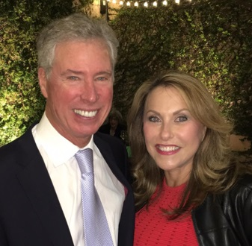
Eda and Cliff Viner
Community Scholars Foundation, Inc.
FOUNDERS
Eda & Cliff Viner
Notes:
Carolyn

Slide 4
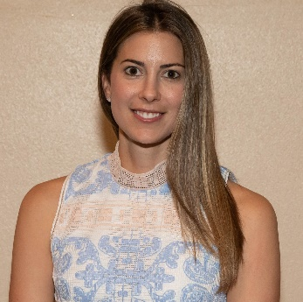
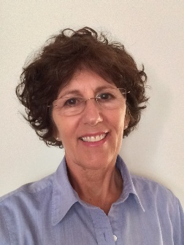
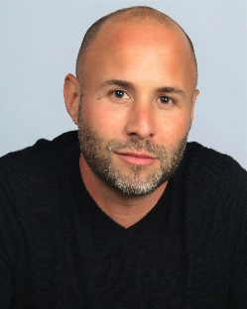
Eda and Cliff Viner
Community Scholars Foundation, Inc.
Niki Knopf Executive Director
Dr. Donna Holland Mentoring Program Director
Michael Rosenfeld Peak Performance Coach
Notes:
Carolyn

Slide 5
Eda and Cliff Viner
Community Scholars Foundation, Inc.
Unique Scholarship Program
Substantial 4 Year Financial Assistance
Intensive mentorship program
Extensive community social services support
Notes:
Cliff & Eda

Slide 6
Eda and Cliff Viner
Community Scholars Foundation, Inc.
SCHOLARSHIP PROGRAM
Approx. 30 new students each year
Florida Public Universities or Colleges
“Last dollar” scholarship - the student first must access other potential sources of financial aid prior to applying.
Amount is determined based on other aid and need and does not exceed University’s estimated cost of attendance
Scholarship covers tuition/fees, room and board, and books/supplies, not already covered by other financial aid
Up to $10,000 per student, per year
Notes:
Carolyn

Slide 7
Eda and Cliff Viner
Community Scholars Foundation, Inc.
SCHOLARSHIPS AWARDED
18 scholarships in June 2015
28 scholarships in June 2016
35 scholarships in June 2017
30 scholarships in June 2018
29 scholarships in June 2019
34 scholarships in June 2020
124 Viner Scholars Attending College in Fall 2020
Approaching 100% graduation rates

Slide 8
Eda and Cliff Viner
Community Scholars Foundation, Inc.
Partnership with Florida Prepaid Foundation
Project Star Scholarship (Apply in 10th grade)
For at risk high students identified before 11th grade
3 scholarships in June 2018 to current College Freshmen
9 scholarships in June 2019, HS Seniors
6 scholarships in June 2020, HS Juniors
First Generation Scholarship
For incoming first-generation freshman college students
12 scholarships to current College Sophomores
16 scholarships to current College Freshmen
Legacy Scholarship
pays tribute to a noteworthy citizen, cause or organization that exemplifies education excellence and/or community service
4 scholarship to current college scholars

Slide 9
Eda and Cliff Viner
Community Scholars Foundation, Inc.
MENTORSHIP PROGRAM
Created mentor network to ensure highest possible college graduation rates:
Mentors
selected from qualified local volunteers
are background checked
have a min of a 4-year college degree
Trained and certified by Dr. Donna Holland
Mentor/Student matching process
Students
make weekly contact
submit monthly report
Notes:
Cliff & Eda

Slide 10
Eda and Cliff Viner
Community Scholars Foundation, Inc.
WHO’S ELIGIBLE FOR THE SCHOLARSHIP
Attend one of our 12 partner High Schools
Achieve at least a 3.0 unweighted GPA
Perform over 100 hours community service during high school
Accepted to a Florida Public University
Demonstrate the need for significant financial assistance
Notes:
Carolyn

Slide 11
Eda and Cliff Viner
Community Scholars Foundation, Inc.
First Requirement: Must Attend one of our 12 HIGH SCHOOL PARTNERS
Academic Solutions Academy
American Heritage High School
Atlantic Community High School
Boca Raton Community High School
Donna Klein Jewish Academy
Katz Yeshiva High School
Marjory Stoneman Douglas High School
Olympic Heights Community High School
Saint John Paul II High School
Spanish River Community High School
Village Academy of Delray
West Boca Raton Community High School
Notes:
Eda

Slide 12
Eda and Cliff Viner
Community Scholars Foundation, Inc.

Slide 13
Eda and Cliff Viner
Community Scholars Foundation, Inc.
Florida Public Universities thus far
Florida Atlantic University
Florida A&M University
Florida International University
Florida Polytechnic University
Florida State University
Palm Beach State College
University of Central Florida
University of Florida
University of South Florida
University of North Florida
Sante Fe Community College
Notes:
Eda

Slide 14
Eda and Cliff Viner
Community Scholars Foundation, Inc.

Slide 15
Eda and Cliff Viner
Community Scholars Foundation, Inc.

Slide 16
Eda and Cliff Viner
Community Scholars Foundation, Inc.
SCHOLARSHIP APPLICATION
Apply online at:
Applications Open: Dec 8th, 2020 – March 8th 2021
Answer questions about yourself
Upload College Acceptance Letter
Upload SAT/ACT scores
Upload FAFSA Electronic Student Aid Report
Mail Transcript – GPA and Community Service is verified with Transcript
vinerscholars.org
Notes:
Carolyn

Slide 17
Eda and Cliff Viner
Community Scholars Foundation, Inc.
SCHOLARSHIP APPLICATION PROCESS
1. Applications are reviewed, Information is verified.
2. Approx. 50-60 applicants are chosen for a 30-minute Interview.
3. Final selection is made & all applicants are notified by the end of May.
vinerscholars.org
Notes:
Carolyn

Slide 18
Eda and Cliff Viner
Community Scholars Foundation, Inc.
OUR COMMUNITY PARTNERS
​
American Association of Caregiving Youth
Supports our Caregiving Scholars through specialized
counseling and in-home visits and support
A Squared Consulting Services
Bring our mentors and students webinar sessions
Dr. Peter T. Blumenthal, DDS
Provides free dental cleanings, x-rays and exams
to our Scholars
Boca Raton Regional Hospital
Provides free physical exams & inoculations prior
to attending college
Boys & Girls Club of Palm Beach County
The Clubs provide a variety of award-winning developmental programs to help youth build skills, self-esteem and values during critical periods of growth.
Notes:
Eda

Slide 19
Eda and Cliff Viner
Community Scholars Foundation, Inc.
OUR COMMUNITY PARTNERS
​
Boca West Community Charitable Foundation
Providing 2 new scholarships each year for 4 years,
commencing 2016.
Nelson Mullins Broad & Cassel
Offers free legal guidance and advice when needed to our Scholars
and their families.
Direct Primary Eye Care- Rachel Huerta, ARNP
Provides free physical exam as determined based on need.
Eye Associates of Boca Raton
Provides free eye exams and discounts on eye glasses.
Faulk Center for Counseling
Provides no-cost counseling services (group or individual) to the students
and families.
Florida Prepaid College Foundation
Provides $11,000 in matching funds for our Viner Scholar/Florida Prepaid Legacy Match Scholarship awarded to one of our students.
​
Notes:
Eda

Slide 20
Eda and Cliff Viner
Community Scholars Foundation, Inc.
OUR COMMUNITY PARTNERS
Dr. David Lubetkin, MD FACOG
Provides annual gynecological appointments for all of our female
Viner Scholars.
Konis Family Dental
Provides free dental cleanings and x-rays to our Scholars
Levis JCC
Provides complimentary family memberships to Health
& Wellness facilities, community service opportunities,
vouchers for Thrift Shop, and job opportunities for scholars.
Propel
Provides after-school programming, community involvement and
enrichment activities, job placement support.
Ronald L. Rubin, DMD- Oral and Maxillofacial Surgery
Provides free dental services for our scholars.
Milagro Center
Provides programs including tutoring to our high school students.
Notes:
Eda

Slide 21
Eda and Cliff Viner
Community Scholars Foundation, Inc.
OUR COMMUNITY PARTNERS
Rotary Club Downtown Boca Raton
Offers job placement and internships, as well as mentoring.
Ruth & Norman Rales Jewish Family Services
Provides our Scholars and their families with services
And book scholarships for new scholars each year.
Southern Scholarship Foundation
Provides rent free housing for students attending college
or university at Flagler-Tallahassee, FAMU,
FGCU, FSU, Flager College -Tallahassee, SFC, TCC, or UF.
Urban League of Palm Beach County
Offers youth & education programs including financial
tools and services.
Vitality Spine and Wellness
Chiropractor
Notes:
Eda

Slide 22
Eda and Cliff Viner
Community Scholars Foundation, Inc.
How to Support Us
Become a Mentor or Recruit a Mentor
Become a Community Partner
Sponsor a Scholarship

Slide 23
Eda and Cliff Viner
Community Scholars Foundation, Inc.
How to Stay Up to Date
Follow us on Instagram @VinerScholars
Like our Facebook Page Eda and Cliff Viner Community Scholars Foundation
Read our monthly Newsletter

Slide 24
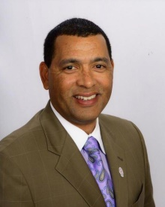
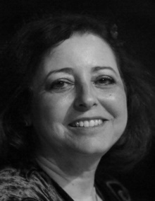
Eda and Cliff Viner
Community Scholars Foundation, Inc.
OUR BOARD OF DIRECTORS
PATRICK FRANKLIN
Patrick Franklin is the President/CEO of the Urban League of Palm Beach County. Under Patrick’s leadership the affiliate has grown the budget via new programming and services while serving over 16,000 residents annually. The ULPBC has become the leader in Youth & Education Development with signature programs such as its National Award winning NULITES youth program and National Achievers Society (NAS).
ONDINA FELIPE
Ondina Felipe served over a decade as General Counsel at Florida Atlantic University, and also to its Foundation and its Research Corporation. She also became a full-time faculty member at FAU's College of Business where she taught Business and Employment Law for the past ten years.

Slide 25
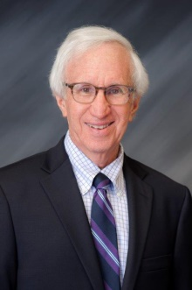
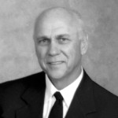
Eda and Cliff Viner
Community Scholars Foundation, Inc.
OUR BOARD OF DIRECTORS
JEFFREY DEUTCH
Jeffrey Deutch is the founding and managing partner of Broad and Cassel's law office. During his more than 35-year career with the firm, he has been instrumental in building the Boca office to its current size and stature.
JAMES ROSEMURGY
James Rosemurgy is the Founder and Chairman of Rosemurgy Properties since 1977. The company’s mission is to build and maintain a diversified portfolio through conservative and profitable growth in geographic areas where the company maintains a competitive advantage.

Slide 26
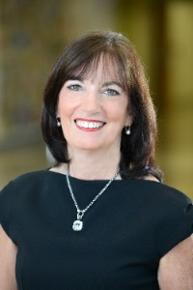
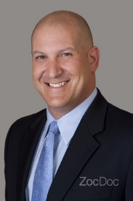
Eda and Cliff Viner
Community Scholars Foundation, Inc.
OUR BOARD OF DIRECTORS
TERRY FEDELE
Terry Fedele has worked actively as a passionate community volunteer and leader in both western Pennsylvania and south Florida over the last 30 years. For the past fifteen years, she has served as the primary marketing consultant and Practice Liaison for Physical Rehabilitation Services, one of the premier physical therapy practices located in western Pennsylvania.
DR. DAVID LUBETKIN
Dr. Lubetkin is a graduate of Johns Hopkins University and Albert Einstein College of Medicine. He completed his residency in Obstetrics and Gynecology at North Shore University Hospital, Cornell University Medical Center in Manhasset, NY. He has been in private practice in Boca Raton, FL since 1996. He has served as Chief of Staff at West Boca Medical Center and President of the Palm Beach County Ob/Gyn Society. Dr. Lubetkin also serves as an Affiliate Assistant Professor of Clinical Biomedical Science at the Charles E. Schmidt College of Medicine at Florida Atlantic University.

Slide 27
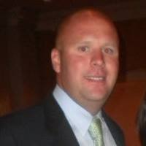
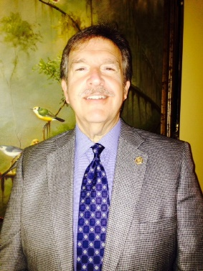
Eda and Cliff Viner
Community Scholars Foundation, Inc.
OUR BOARD OF DIRECTORS
DAN PAULUS
Dan graduated from Florida State University and is currently the Director of Community Relations for GFA International –Universal Engineering Sciences Conglomerate. He is Founder and Chairman of the Renegades of Reel Estate Fishing Classic which organizes local networking events for Alumni, current students and others involved in real estate to build relationships. He also serves on the Greater Delray Beach Chamber of Commerce Board of Directors.
ALAN KAYE
Alan is currently a Broker- Associate for Douglas Elliman Commercial Real Estate. He has worked in real estate for 30 years. Prior to being a broker, he was a practicing attorney and graduated from Hofstra School of Law. He is also the Founder and Inaugural President of the Rotary Club Downtown Boca Raton, Co-creator of the C.H.O.W. program, (Children’s Health on the Weekend) with a fellow RCDBR Rotarian with our Community Partner, Florence Fuller Children Development Center, and Chair and Co-chair of Honor Your Doctor Luncheon for last seven years, which provides health and wellness scholarships to deserving Medical and Nursing students who attend FAU Medical & Nursing, Lynn University and PBSC.

Slide 28
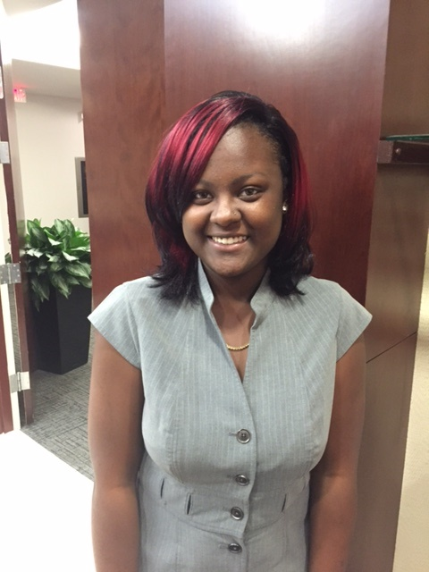
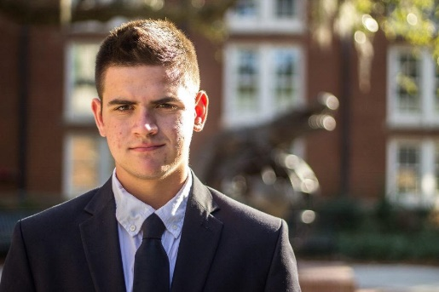
Eda and Cliff Viner
Community Scholars Foundation, Inc.
What The Viner Scholars Are Saying…
"I had a wonderful experience with the Viner Scholarship program and its amazing staff. Everyone was so nice and welcoming. They have given me the opportunity to pursue my education without having to stress about the financial burden
I would've imposed on myself and on my family. I can't thank them enough for their generosity and their passion in making a difference in teenager's lives. "
~ Alexus Foster
2016 Viner Scholar
"As I approach my senior year, it has been such a blessing in my life and my family’s life to have this much-needed financial assistance; my collegiate experience would have been vastly different without it. The fact that on top of years of financial assistance and mentorship, you all were also able to help me get a paid internship at a large, national law firm is truly incredible and I am eternally grateful. It really proved to me that I want to be a lawyer and I could not have asked for a better summer employer. I am genuinely sad to leave and did not think I’d ever feel that way about a summer internship!"
~ Daniel Bencivenga
2016 Viner Scholar
Notes:
Cliff & Eda

Slide 29
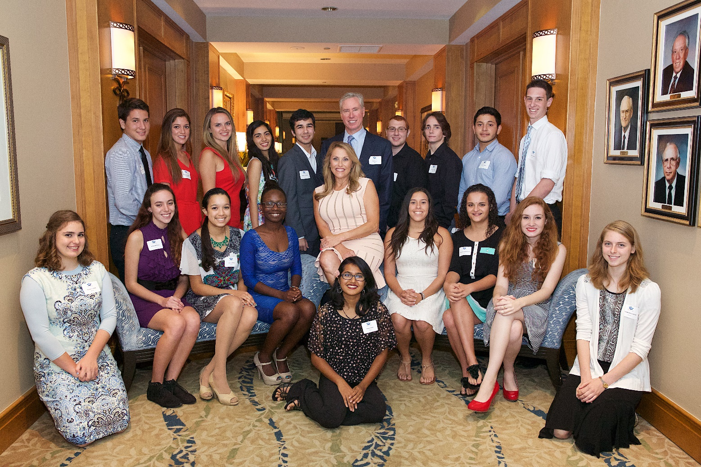
Eda and Cliff Viner
Community Scholars Foundation, Inc.
2015 VINER SCHOLARS
Notes:
Carolyn

Slide 30
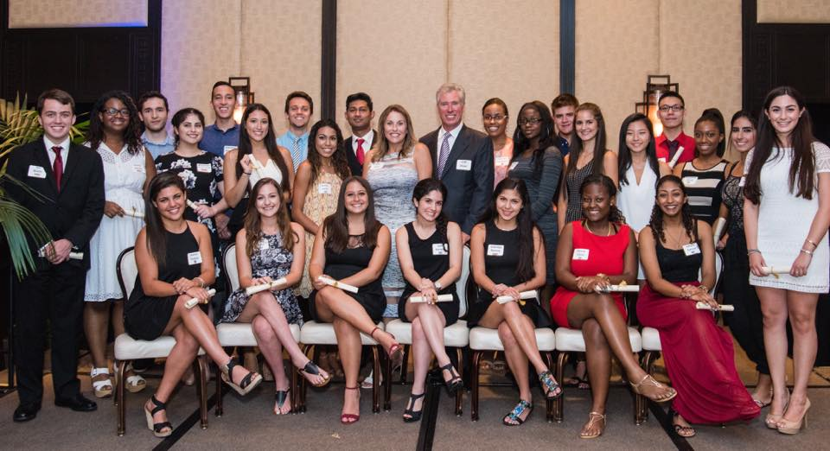
Eda and Cliff Viner
Community Scholars Foundation, Inc.
2016 VINER SCHOLARS
Notes:
Carolyn

Slide 31
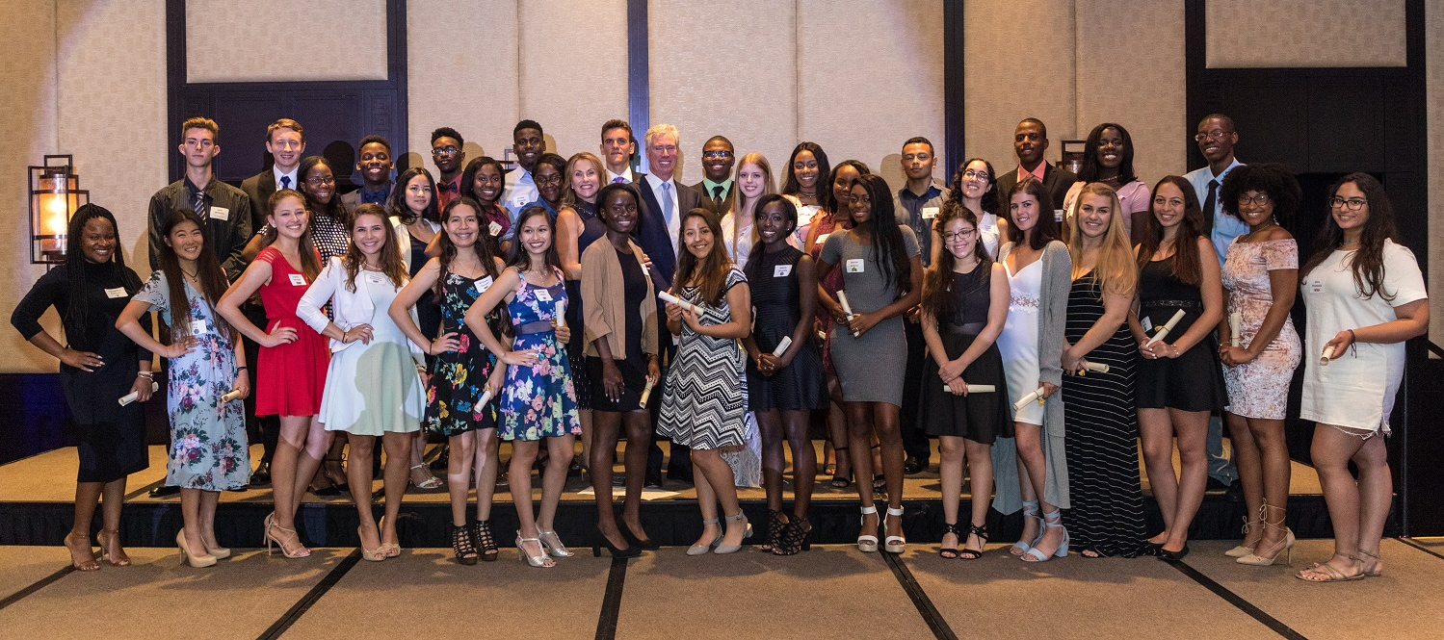
Eda and Cliff Viner
Community Scholars Foundation, Inc.
2017 VINER SCHOLARS
Notes:
Carolyn

Slide 32
Eda and Cliff Viner
Community Scholars Foundation, Inc.
2018 VINER SCHOLARS

Slide 33
Eda and Cliff Viner
Community Scholars Foundation, Inc.
2019 VINER SCHOLARS

Slide 34
Eda and Cliff Viner
Community Scholars Foundation, Inc.
2020 VINER SCHOLARS

Slide 35
Notes:
Carolyn

